Slide 1
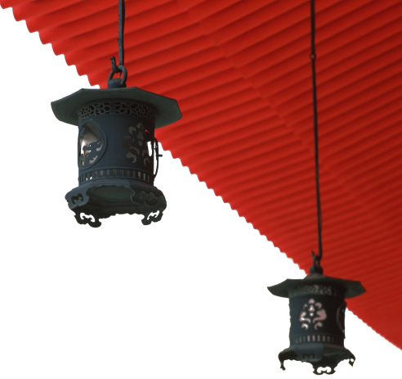

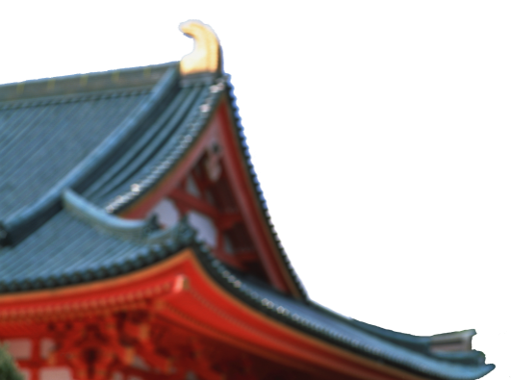
中国文化概况
A GLIMPSE OF CHINESE CULTURE

Slide 2
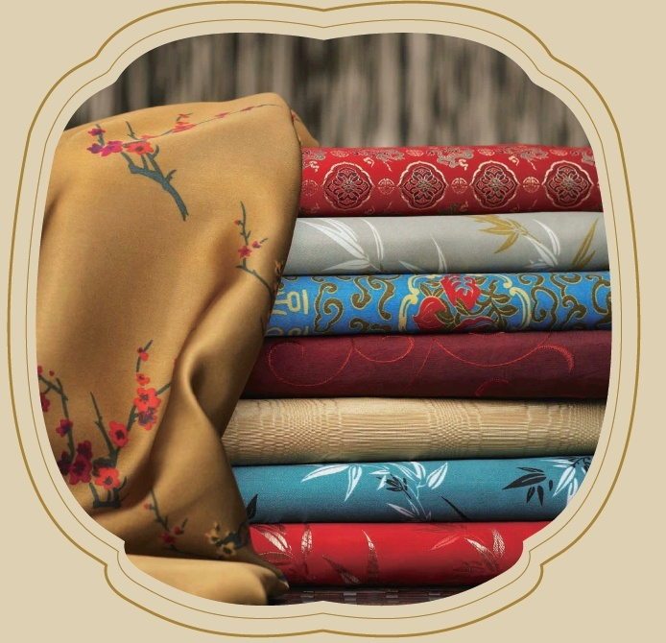
Chapter 9 Costume & Adornment

Slide 3

学习目标
介绍中国服饰发展概况；
了解中国服饰元素及技艺；
了解中国少数民族服饰。

Slide 4
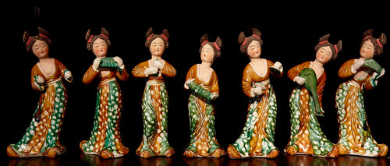
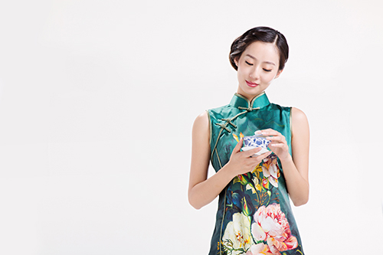
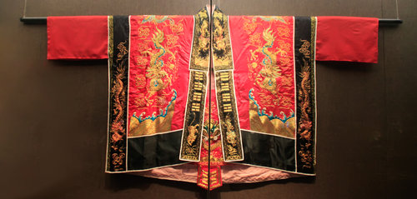
1
2
Overview
3
Lead-in Activity
Chinese Clothes
Discussion &
Presentation

Slide 5
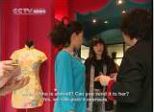

Lead-in Activity
Discuss
Watch the video and discuss why do young people like qipao now? Work in groups and discuss how would you like to introduce qipao to your foreign friend.

Slide 6
1
2
Overview
3
Lead-in Activity
Chinese Clothes
Discussion &
Presentation

Slide 7
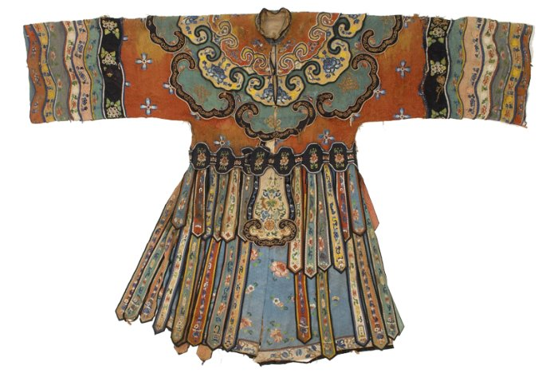
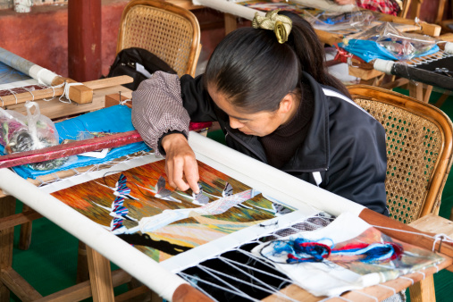
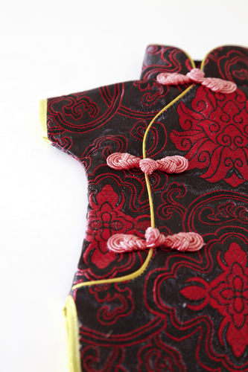
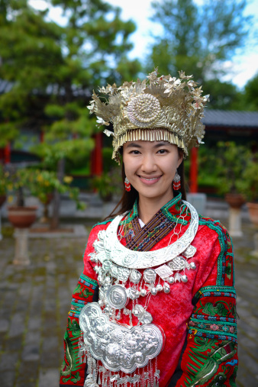
Text Study
1
2
3
4
Development of Chinese Costume
Distinct Features of Chinese Costume
Typical Chinese Costumes
Costumes of Chinese Ethnic Minorities

Slide 8
Development of Chinese Costume
Origins of Chinese Costume
Zhou dynasty
Spring and Autumn and Warring States
Qin dynasty
Wei, Jin and Southern and Northern dynasties
Tang dynasty
Song dynasty
Yuan dynasty
Ming dynasty
Qing dynasty
Modern clothes

Slide 9
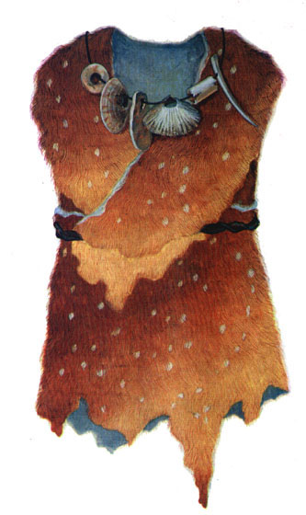
Development of Chinese Costume
Origin of Chinese Costume
people covered themselves with natural materials like leaves, grasses and animal furs
with the invention of sewing, better clothes are made possible
assists in people’s adaptability, resulting in the expansion of territories and the increase in productivity

Slide 10
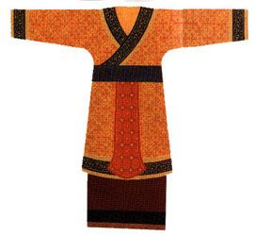
Development of Chinese Costume
Clothes in Zhou dynasty
rules of clothes etiquette started in the Zhou dynasty
sacrificial attire, court attire, army uniform, mourning attire and wedding attire are classified

Slide 11
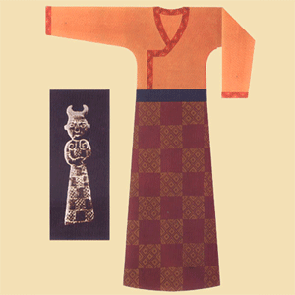
Development of Chinese Costume
Clothes in Spring and Autumn and Warring States
in different styles
different states use different styles of clothes to display their
state identity

Slide 12
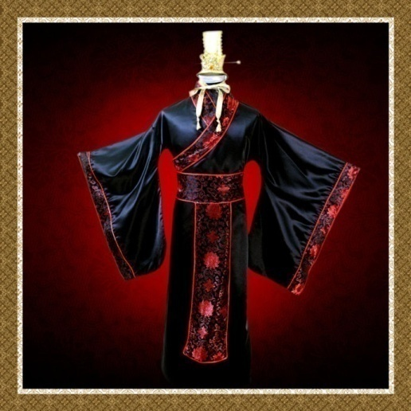
Development of Chinese Costume
Clothes in Qin and Han Dynasties
style of clothes is changed dramatically
mostly in black in Qin dynasty
mostly in red in Han dynasty

Slide 13
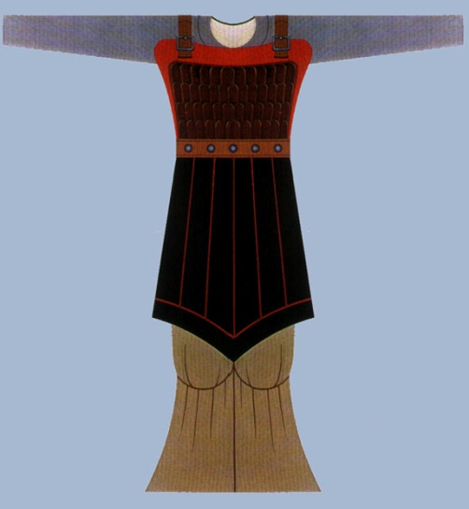
Development of Chinese Costume
Clothes in Wei, Jin, and Southern and Northern dynasties
classified into two categories: the folk costume and the official costume
folk costume: close-fitting, round-collared and vented
official costume: in formal style

Slide 14
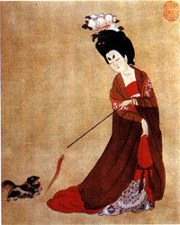
Development of Chinese Costume
Clothes in Tang Dynasty
the styles became more varied as the society was more
open to the outside world
women didn’t have to abide by the traditional dress code
parts of their bodies can be exposed

Slide 15
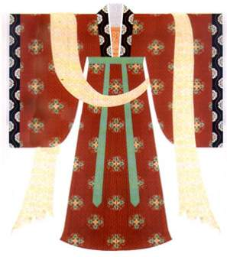
Development of Chinese Costume
Clothes in Song Dynasty
simple and natural
during the period, casual wear appeared
fashionable for women to bind their feet
foot binding didn’t die out until in the early 20th century

Slide 16
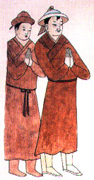
Development of Chinese Costume
Clothes in Yuan Dynasty
simple and unadorned
combines Mongolian and Han influences

Slide 17
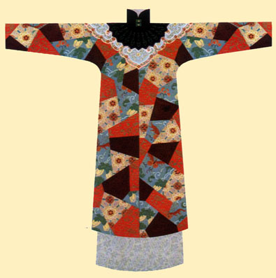
Development of Chinese Costume
Clothes in Ming Dyansty
buttons in the front replaced the band knots that had been in use for several thousands years
decorated with various striking adornments made of gold, jade, pearl, etc

Slide 18
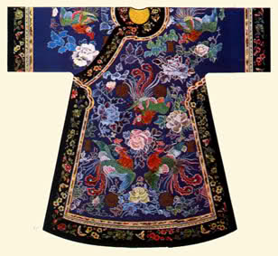
Development of Chinese Costume
Clothes in Qing Dynasty
there was no limitation to one style and natural beauty
was advocated
elegant and poised
people’s status is reflected in their clothes

Slide 19
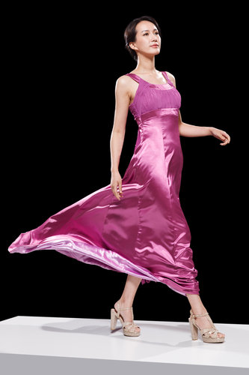
Development of Chinese Costume
Clothes in Modern Day
influenced by Western costumes
traditional elements are added into modern clothes

Slide 20
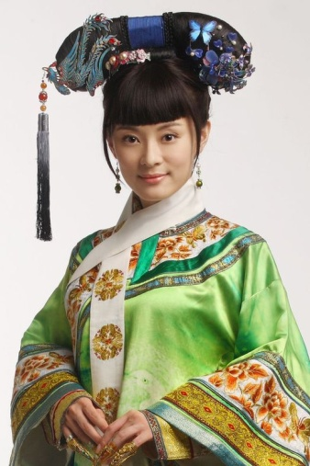
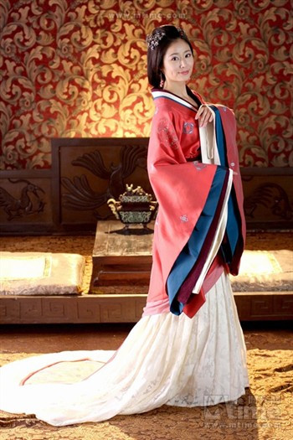
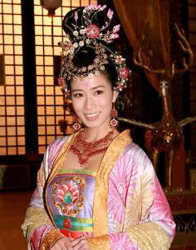
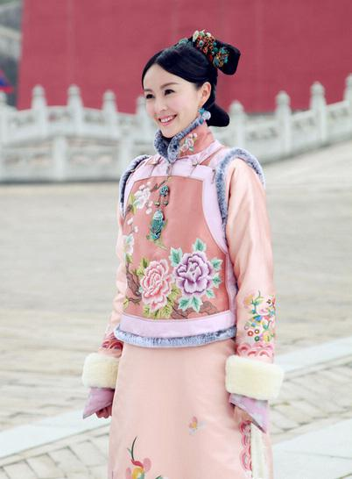
Development of Chinese Costume
Fun Time
The following are some pictures from famous TV series, please tell which dynasties they are from by the clothes they are wearing.
Qing Dynasty
Han Dynasty
Tang Dynasty
Qing Dynasty

Slide 21
1
2
3
4
Development of Chinese Costume
Distinct Features of Chinese Costume
Typical Chinese Costumes
Costumes of Chinese Ethnic Minorities

Slide 22
Distinct Features of Chinese Costume
Silk and the Silk Road
Embroidery
Batik

Slide 23
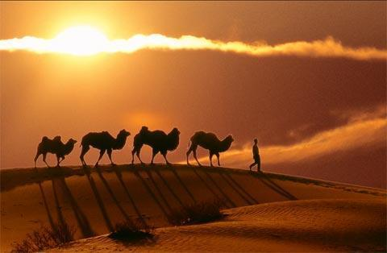
Distinct Features of Chinese Costume
Silk and the Silk Road
Suzhou generally recognized home of Chinese silk
The Silk Road, starting from the Weishui Valley and ending on
the east coast of the Mediterranean, introduced silk to the
world

Slide 24
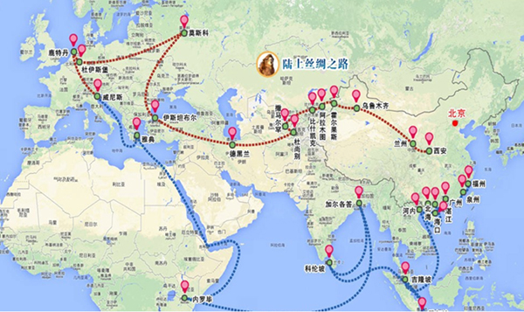
Distinct Features of Chinese Costume
Silk Road Economic Belt
based on the concept of the old silk road
linking China with Central and Western Asia, as well as Europe
regarded as the longest and most prospective economic belt
boosts regional trade and economic development

Slide 25
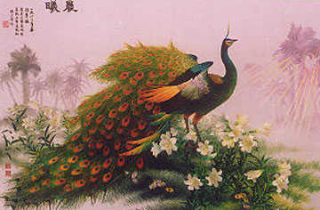
Distinct Features of Chinese Costume
Embroidery
traditional Chinese handicraft
features flowers, birds, scenery on silk or other cloth with
threads
with regional and ethnic characteristics
four most famous types: Sichuan embroidery, Suzhou
embroidery, Hunan embroidery, and Guangdong embroidery

Slide 26
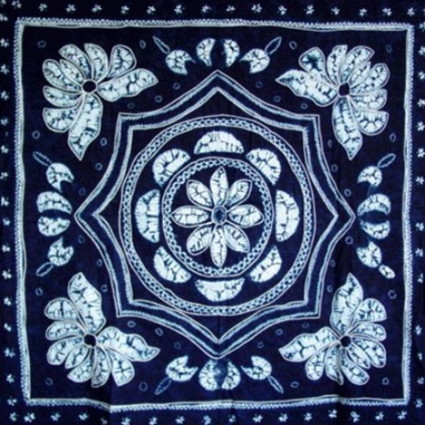
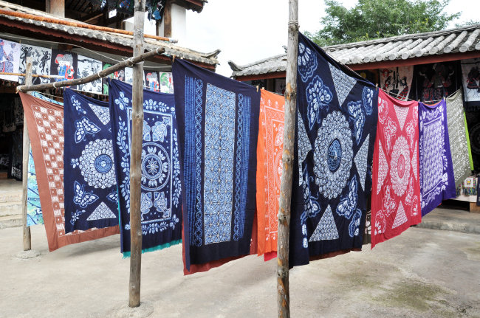
Distinct Features of Chinese Costume
Batik
also known as wax printing
popular among the Buyi, Miao and some other ethnic minority
groups
can be made into garments, scarves, kerchiefs, bags, table
cloths, bedspreads, curtains, and other decorative items

Slide 27
Text Study
1
2
3
4
Development of Chinese Costume
Distinct Features of Chinese Costume
Typical Chinese Costumes
Costumes of Chinese Ethnic Minorities

Slide 28
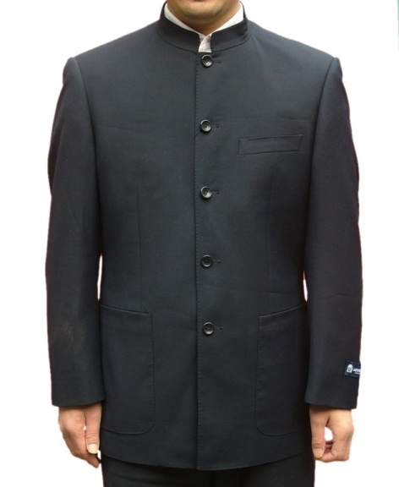
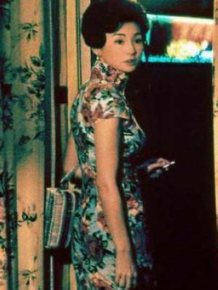
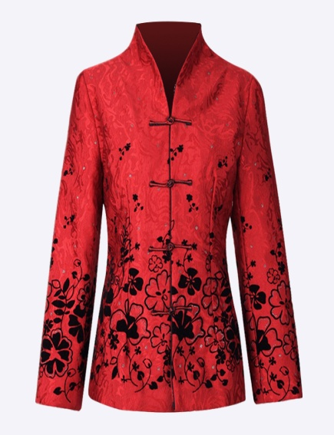
Typical Chinese Costumes
Do you know the following typical Chinese costumes?
Chinese Tunic Suit
Cheongsam(qipao)
Tang Costume

Slide 29
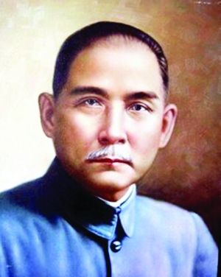
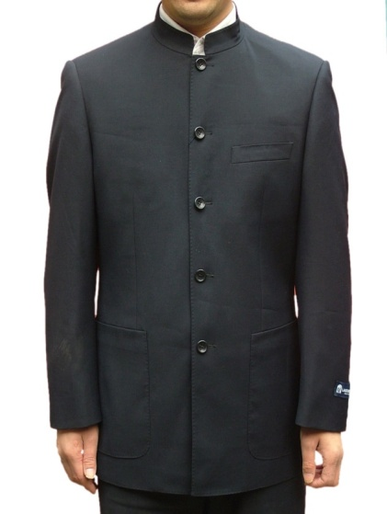
Typical Chinese Costumes
Chinese Tunic Suit
a uniform that Dr. Sun Yat-sen liked to wear and
recommended to the people of the country to wear
with four pockets and a turndown collar, secured with five
central buttons

Slide 30
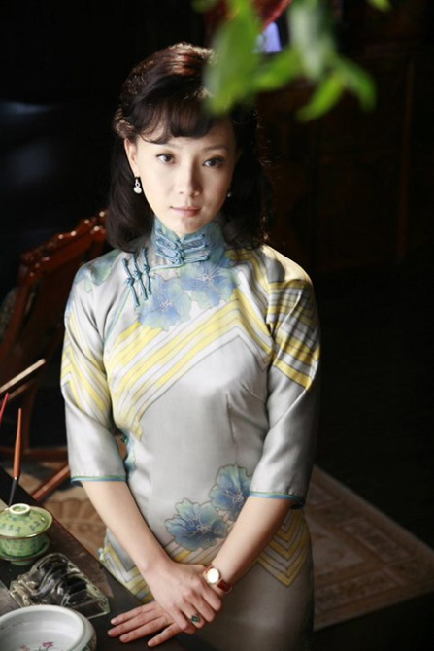
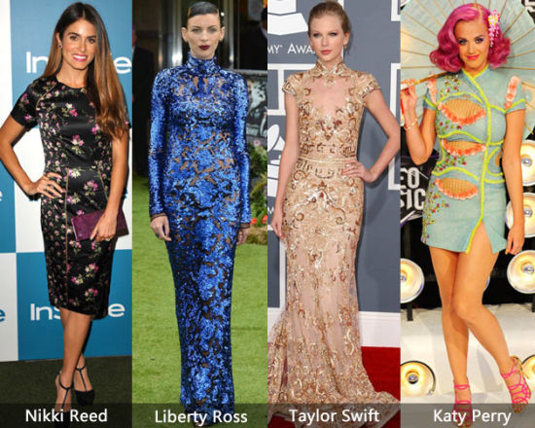
Typical Chinese Costumes
Cheongsam(qipao)
a classic dress for Chinese women
easy and comfortable to wear
elegant and simple
attracts international attention

Slide 31
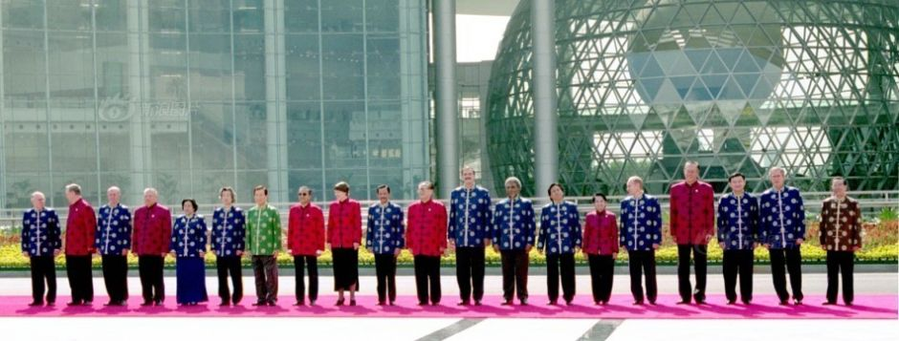
Typical Chinese Costumes
Tang Costume
a representative of Chinese national costumes
inspired by costumes of the Tang dynasty
enjoys worldwide popularity

Slide 32
1
2
3
4
Development of Chinese Costume
Distinct Features of Chinese Costume
Typical Chinese Costumes
Costumes of Chinese Ethnic Minorities

Slide 33
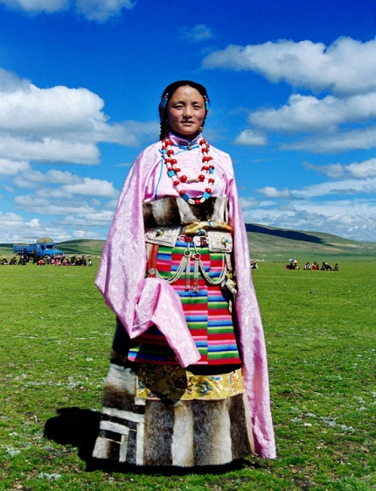
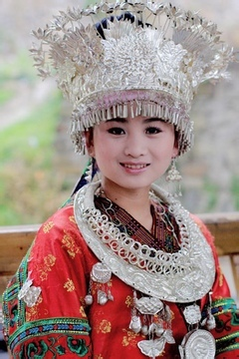
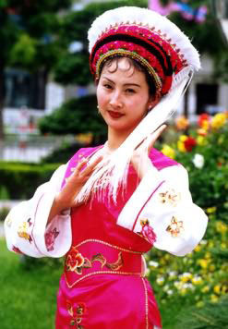
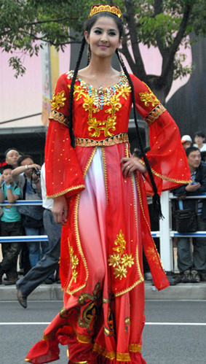
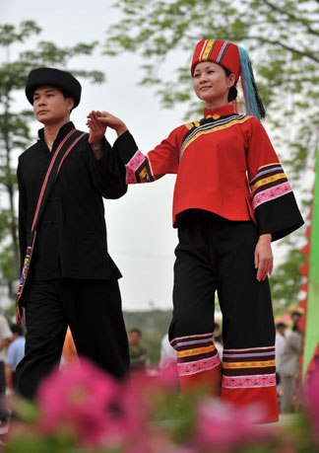
Costumes of Chinese Ethnic Minorities
Tibetan Robe
Miao-style Silver Jewelry
Clothes of Bai People
Clothes of Uygur People
Clothes of Zhuang People

Slide 34
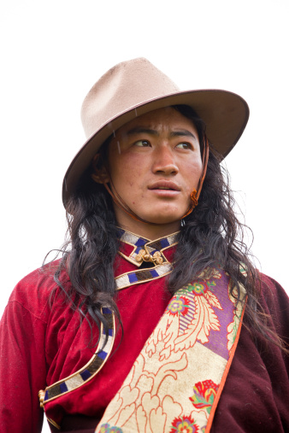
Costumes of Chinese Ethnic Minorities
Tibetan Robe
loose and has long sleeves and a wider-than-usual waist
men tend to wear only one sleeve and pull the other sleeve
around the back to the front
women have more colorful robes

Slide 35
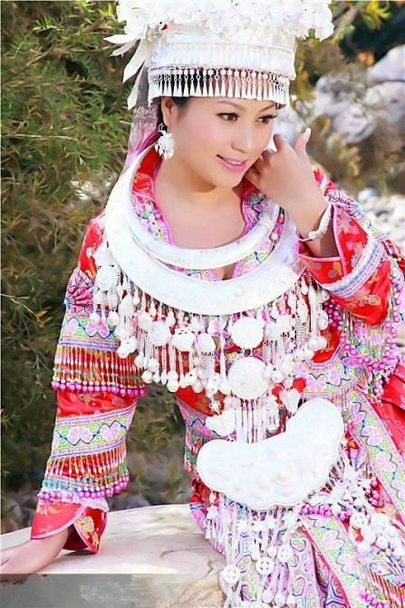
Costumes of Chinese Ethnic Minorities
Miao-Style Silver Jewelry
a complete set of silver jewelry is about 15
kg
the love for silver jewelry stems from the
respect for beauty and dignity
indicates a person’s marital status and
presented as a betrothal gift

Slide 36
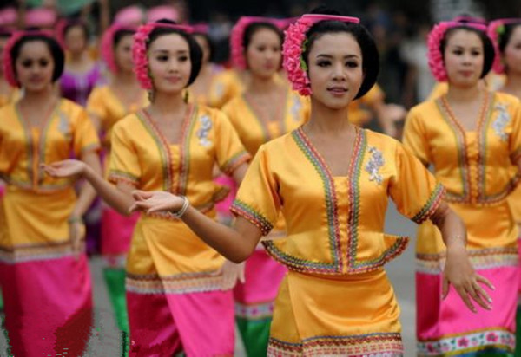
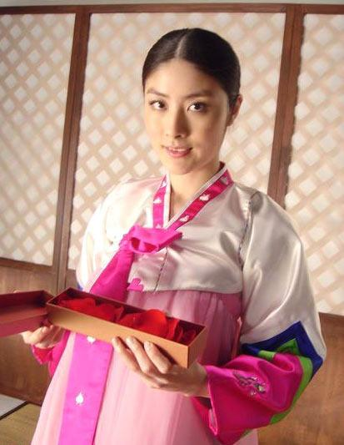
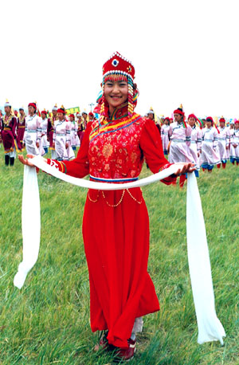
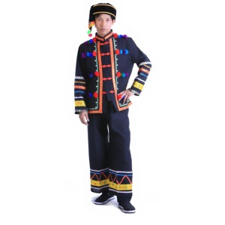
Costumes of Chinese Ethnic Minorities
After reading the text, please match each set of clothes with the ethnic group that it belongs to.
Zhuang People
Mongolian People
Dai People
Korean People

Slide 37
1
2
Overview
3
Lead-in Activity
Chinese Clothes
Discussion &
Presentation

Slide 38

Discussion
In recent years, some traditional Chinese costumes began to appear on different occasions. Take the Tang costume as an example to discuss with your partner the reasons why many Chinese people are reintroducing the traditional costumes into modern life. Then share your opinions with the class.

Slide 39

Students’ Presentation
There are a group of international students in your university who are fascinated by a variety of ethnic costumes in China. In order to help them gain more knowledge and have a better understanding of ethnic costumes, the Students’ Union invite some Chinese students to give a presentation about the costumes of China’s ethnic minorities. You are one of these students and are responsible for introducing the Miao people’s traditional costume. You can turn to the Internet to collect some information.

Slide 40
Students’ Presentation
Miao Ethnic Minority
one of the few minority nationalities that have an extensive
population existing in and out of Mainland China
Guizhou province as the base of Miao ethnic minority group
relies heavily on agriculture and for the most part are an
agrarian society
Miao clothing incorporates hundreds of styles in varying
arrays of color
the reed pipe is the most commonly used musical instrument
during musical serenades or feasts

Slide 41
The End

